Slide 1

Automated Parking Synopsis PPT
Submitted by:
Japman Singh (G12/49/CSE1/2017)
Japneet Singh (G12/50/CSE1/2017)
Jaskaran Singh Kawatra (G12/53/CSE1/2017)
Jaskirat Singh (G12/54/CSE1/2017)
Under the guidance of:
Ms. Basanti Pal Nandi
Department of Computer Science & Engineering
Guru Tegh Bahadur Institute of Technology

Slide 2
Automated Parking
Introduction
Objective
Technologies Used
Procedure for Model
Procedure for App
Flow Diagrams
Concept
Conclusions
References

Slide 3
Introduction
Our project is a one stop solution for all parking problems. It takes care of available parking spaces, ticketing and all parking related charges and payments with support for both Android and IOS devices.
We have also developed a Web-App based admin console to manage backend operations and payment transactions making it easy an convenient for people with non technical backgrounds to operate the system.

Slide 4
Technologies used: 1. Labelbox 2. Colab 3. Jupyter Notebook 4. Keras 5. OpenCV 6. PyTesseract 7. Firebase 8. Flutter
Our project consists of 3 elements
Deeplearning Model trained for number plate recognition.
OpenCV program for plate detection and OCR.
Flutter application to manage data and make payments.
Web-App based admin console.

Slide 5
Procedure for Deep Learning Model
Install a Python distribution with Jupyter Notebook support or use Google Colab’s Jupyter Notebook.
Click pictures manually as well as collect from the internet.
3. Label number plates data using Label Box.
4. Export this data to JSON file.
5. Load it into Pandas dataframe.
6. Train the detection model.
7. Test the model on test cases.
8. Make the model converge.
9. Crop detected image and feed it to Python Tesseract OCR
10. Upload OCR detected output on firebase.

Slide 6
Procedure for Flutter Application
Get the Flutter SDK: Download the installation bundle to get the latest stable release of Flutter.
Setup Android Studio for flutter.
Connect application with Firebase Backend.
Code the Sign-In module with support for Google sign-in from Firebase.
Create Parking, Logs and MyAccount screens and build the flow.
Code the Add Vehicle screen and integrate VehicleInfo-RestfulAPI to obtain Car details from number plate.
Add vehicle details in Cloud-Firestore.
Fetch vehicle number from AI-Model-PyTesseract output and generate parking log in Firebase.
Respond to ping when same number plate is detected at exit. Calculate fare using timestamp and debit amount from payment gateway.

Slide 7
Flow Diagrams

Slide 8
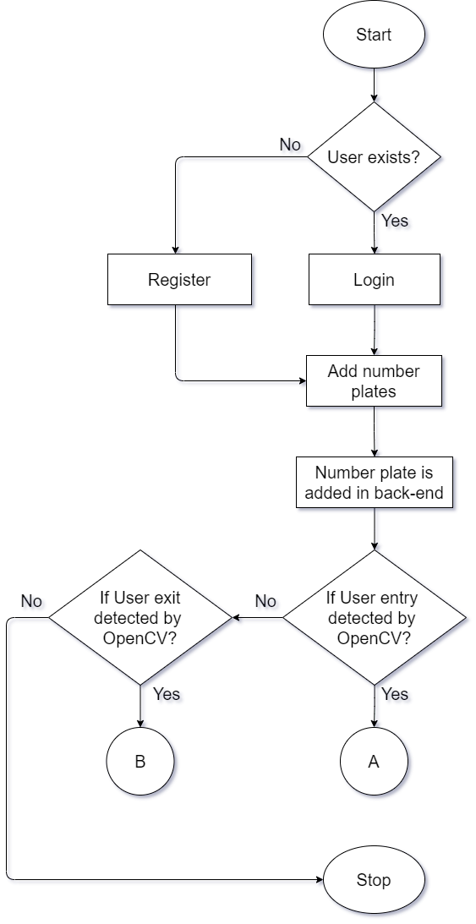
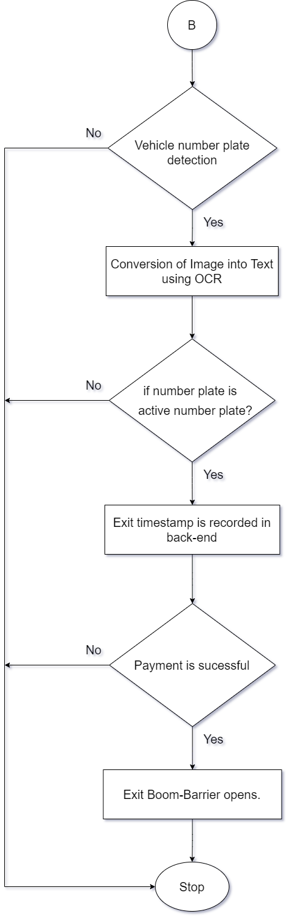
Fig – Application flow Simply Parking (1)
Fig – Application flow Simply Parking (2)
Fig – Application flow Simply Parking (3)

Slide 9
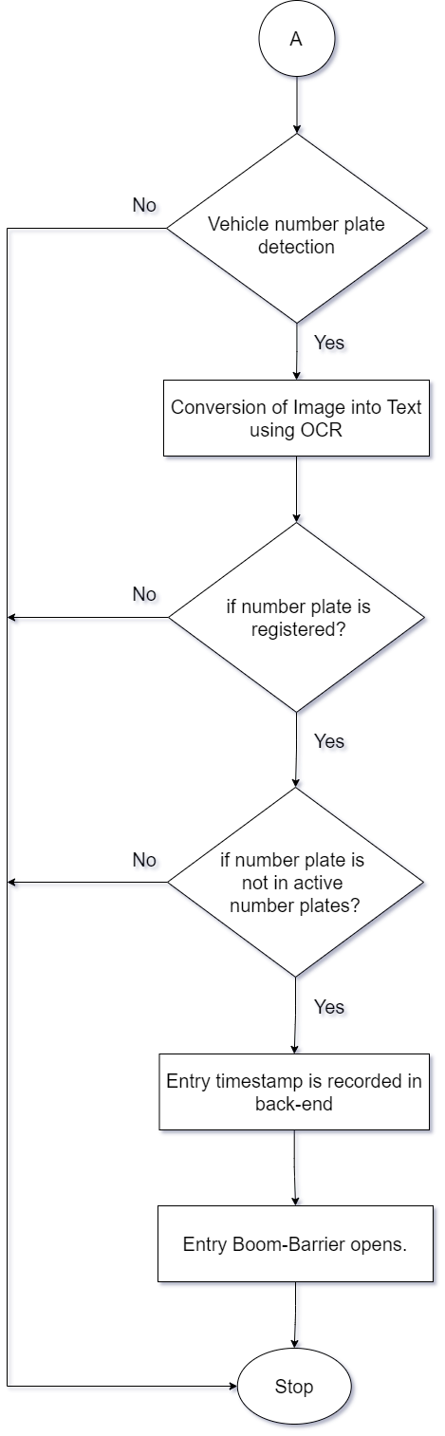
Fig – Application flow Simply Parking (2)

Slide 10
Fig – Application flow Simply Parking (3)

Slide 11
Test Cases

Slide 12
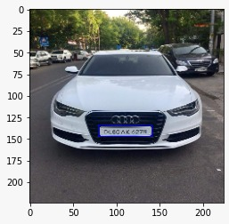
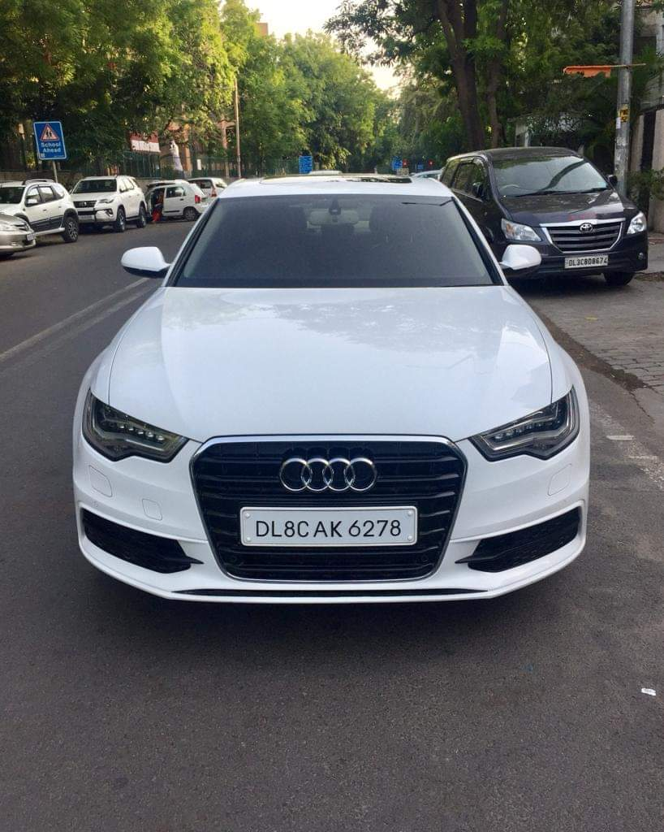
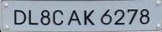
The system has been tested on a series of different test cases based on various types of number plates in India and also abroad.
Expected Output
Expected Output Sample (For Reference)

Slide 13
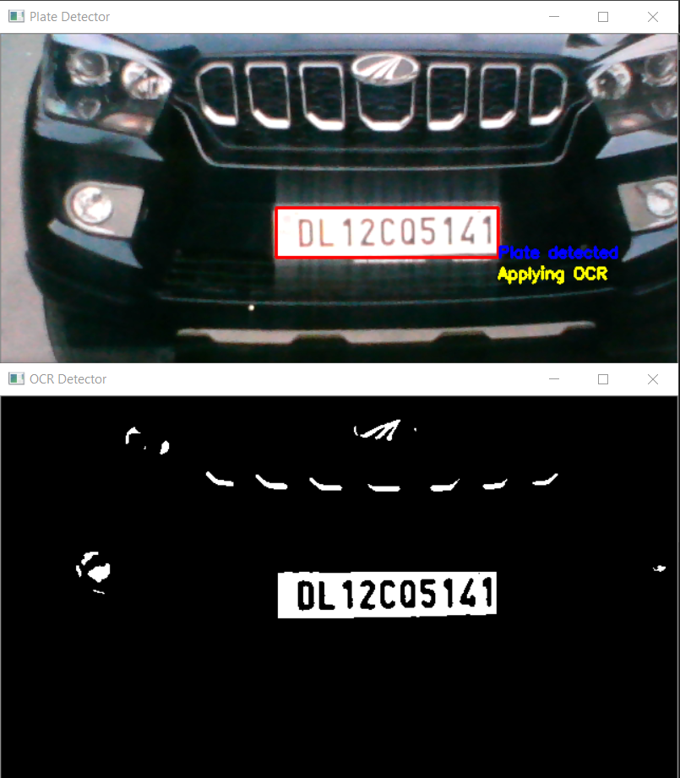
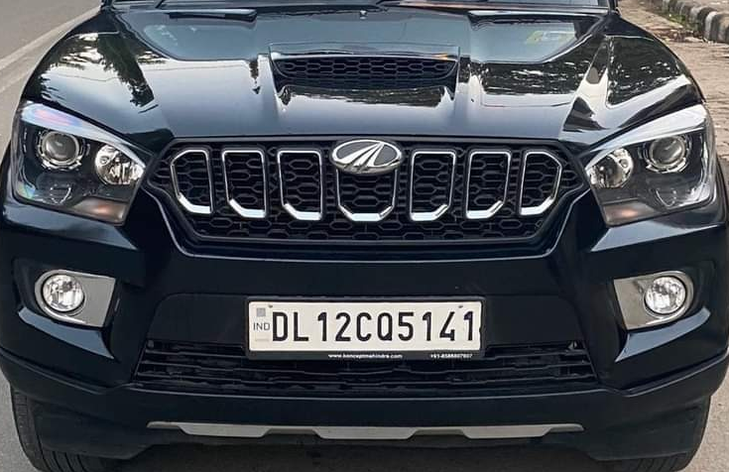
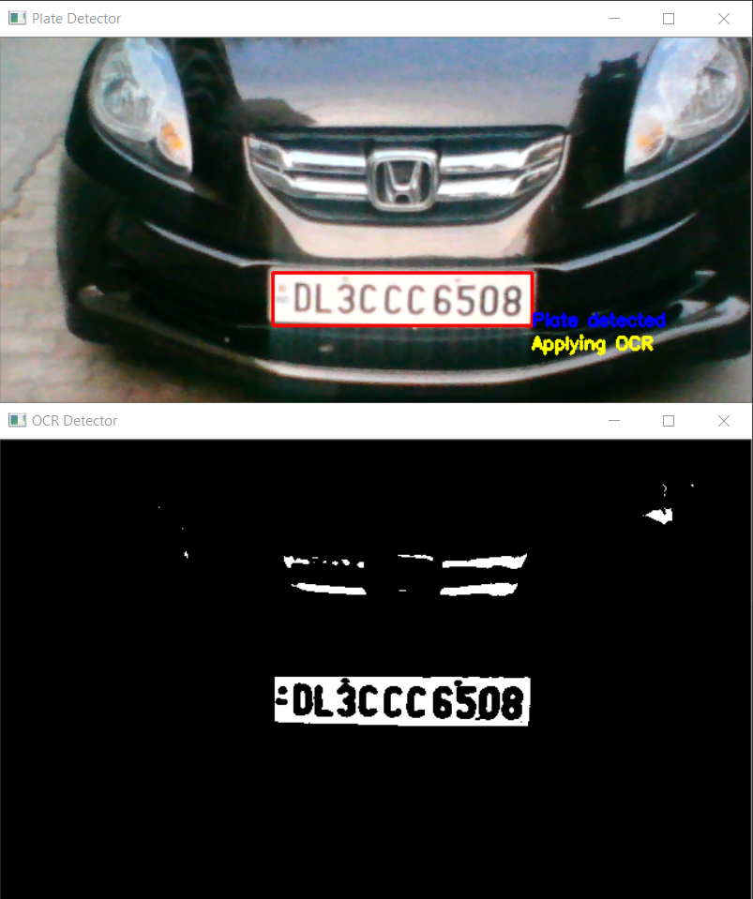
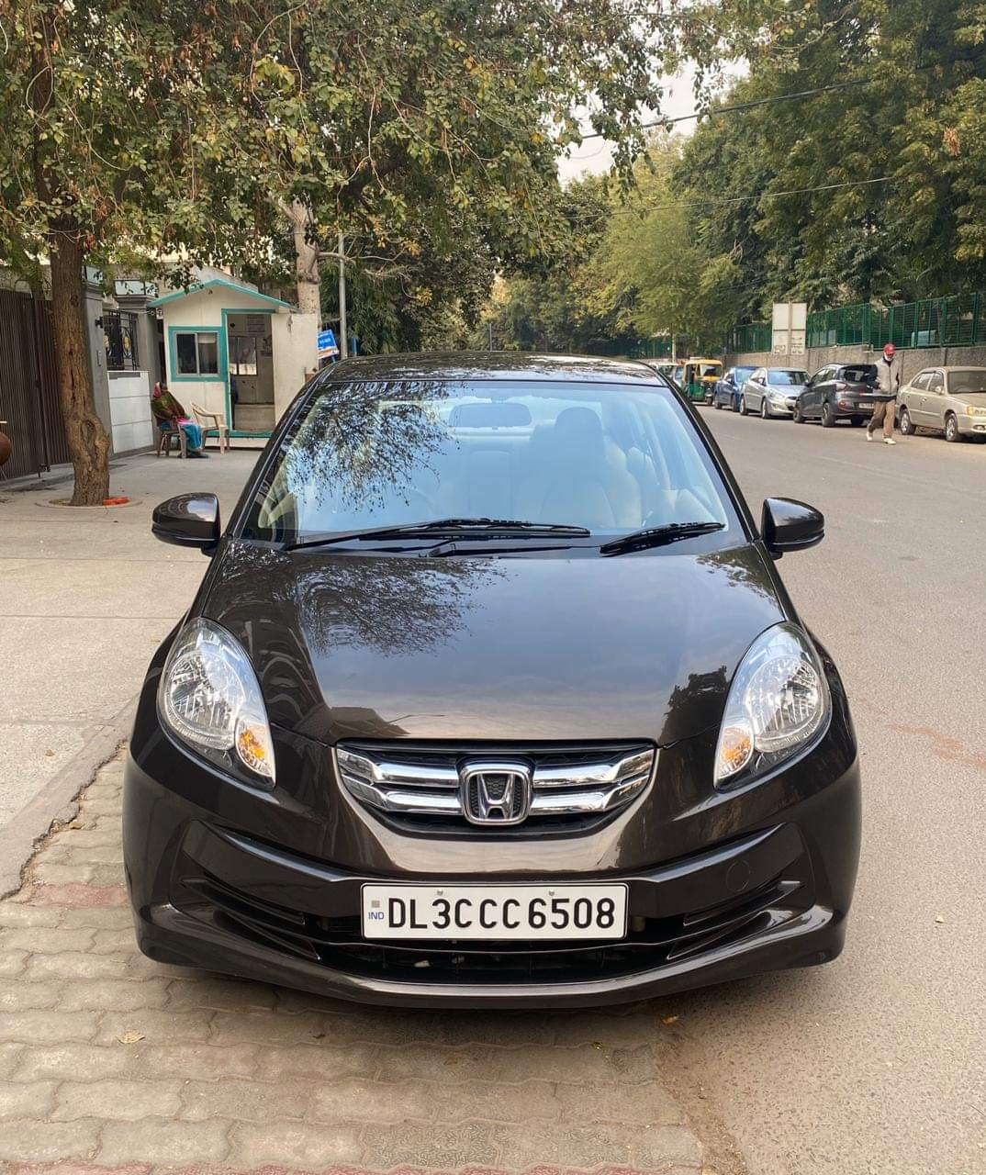
Test Case(1) – Plate Detection
Status - Success
Input Camera Feed
Detected Plate and Mask
Test Case(2) – Plate Detection
Status - Success
Input Camera Feed
Detected Plate and Mask

Slide 14
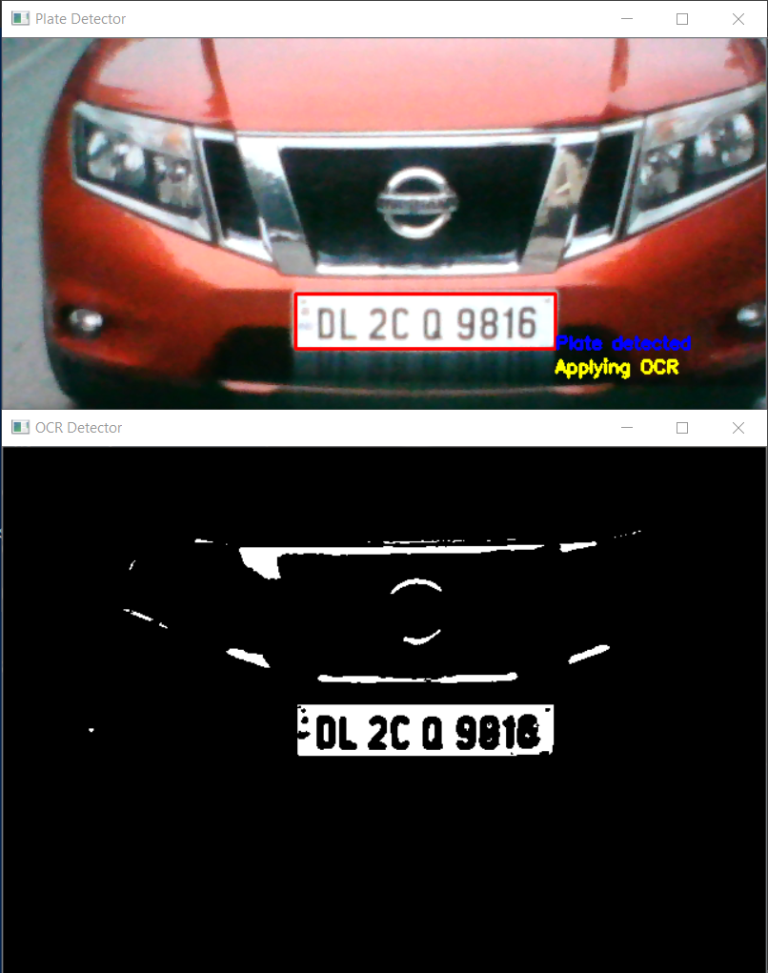
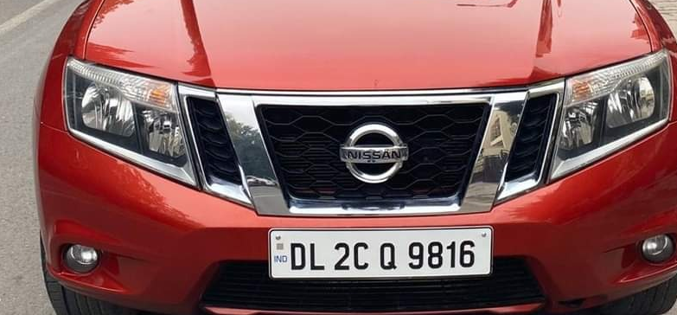
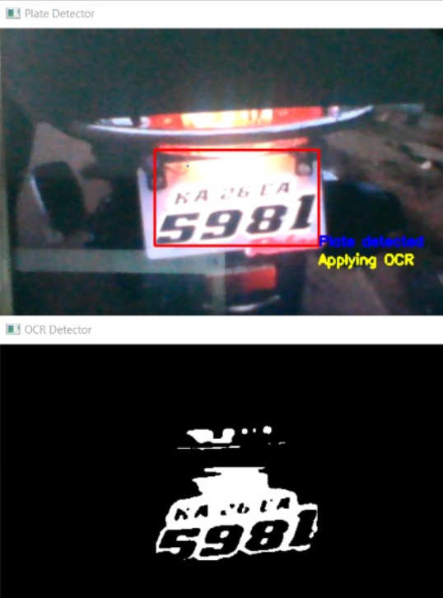
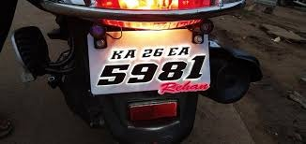
Test Case(3) – Plate Detection
Status - Success
Input Camera Feed
Detected Plate and Mask
Test Case(4) – Plate Detection
Status - Success
Input Camera Feed
Detected Plate and Mask

Slide 15
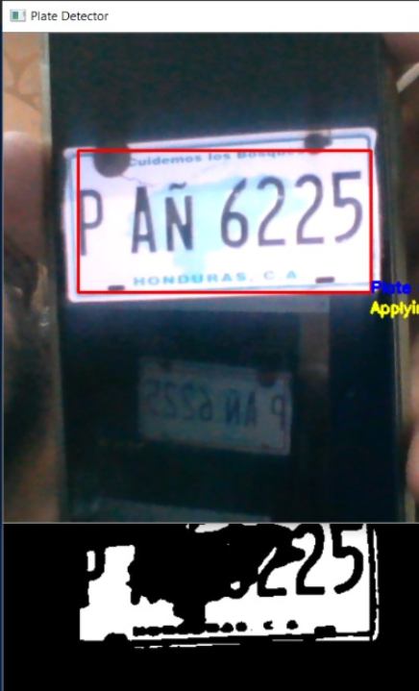
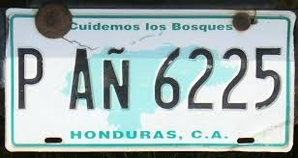
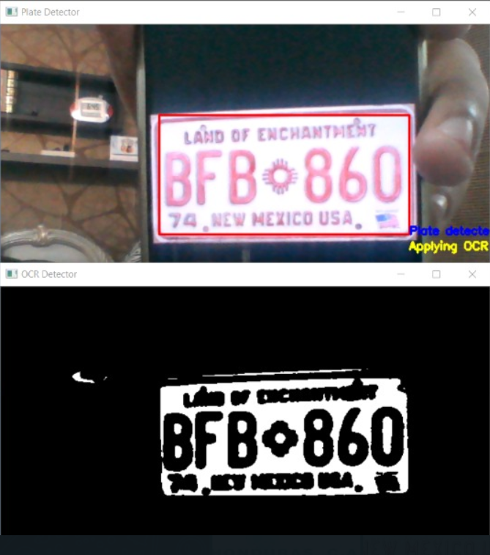
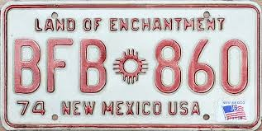
Test Case(5) – Plate Detection
Status - Success
Input Camera Feed
Detected Plate and Mask
Test Case(6) – Plate Detection
Status - Success
Input Camera Feed
Detected Plate and Mask

Slide 16
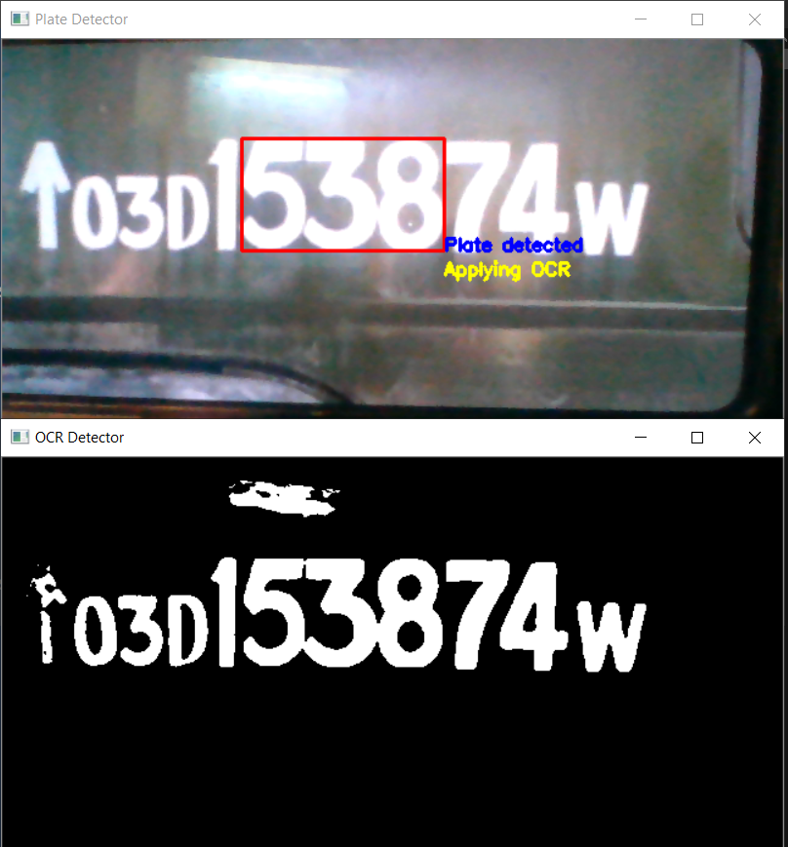
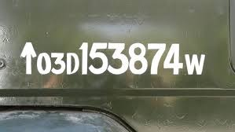
Test Case(7) – Plate Detection
Status - Failed
Input Camera Feed
Detected Plate and Mask
Test Case(1) – OCR
Status - Success

Slide 17
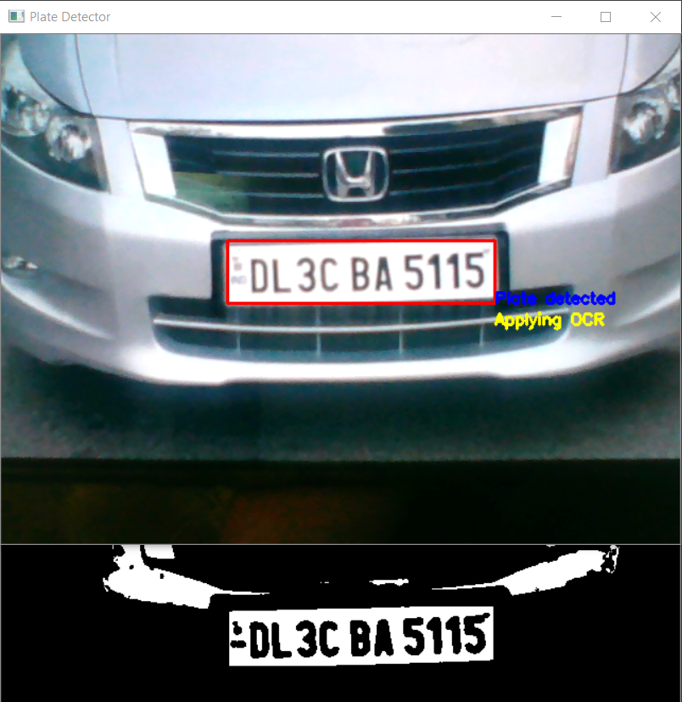

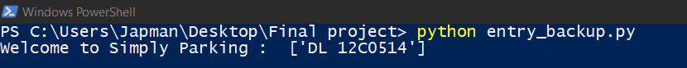
Test Case(2) – OCR
Status - Success
Test Case(3) – OCR
Status - Failed
Reason – Due to Q similar to 0, the system detects last 4 digits as 0514 instead of 5141

Slide 18
Test Case(4) – OCR
Status - Failed
Reason –
Due to Regex based on Indian format, detection fails
Detected Plate and Mask
Test Case(5) – Plate Detection
Status - Failed
Reason –
Due to Regex based on Indian format, detection fails
Detected Plate and Mask

Slide 19
References
Books, Journals and Articles
[1] O’Reilly - Hands On Machine Learning with ScikitLearn, Keras and TensorFlow, Pg 80-165
[2] Allibai, E. (2018, November 21). Building a deep learning model using Keras. Medium. https://towardsdatascience.com/building-a-deep-learning-model-using-keras-1548ca149d37
[3] Zhang, Wei (1988). "Shift-invariant pattern recognition neural network and its optical architecture". Proceedings of Annual Conference of the Japan Society of Applied Physics.
[4] Vishal Gupta – Restful API Guide - https://shrouded-falls-48764.herokuapp.com/docs/readme.html
[5] Venkatachalam, M. (2020, May 14). Introduction to object detection. Medium. https://towardsdatascience.com/introduction-to-object-detection-943f21e26063
[6] Labenz, C. (2020, October 15). Testable flutter and cloud Firestore. Medium. https://medium.com/flutter/testable-flutter-and-cloud-firestore-1cf2fbbce97b
[7] Uther, ​. (2017). Temporal difference learning. Encyclopedia of Machine Learning and Data Mining, 1233-1240. https://doi.org/10.1007/978-1-4899-7687-1_817
[8] Wright, S. (2013). App logic components. Pro SharePoint 2013 App Development, 245-282. https://doi.org/10.1007/978-1-4302-5885-8_9
Online References
[1] https://flutter.dev/docs/reference/tutorials
[2]. https://www.w3adda.com/flutter-tutorial
[3] https://stackoverflow.com/questions/49072957/flutter-dart-open-a-view-after-a-delay

